Slide 1
Welcome 508 Coordinators!
December 5, 2017

Slide 2
Agenda for the day
Time | Presenter | Topic
8:30-9:00 | NA | Registration/networking
9:00 – 9:10 | Helen Chamberlain | Welcome
9:10 - 9:30 | Dean Halstead | Modernization of IT and 508 refresh Taking accessibility beyond compliance
9:30-10:30 | Peter Frem | Accessible authoring & content - strategy, roadmap & demo’s
10:30 – 10:45 | Break | Break
10:45 – 12:00 | Aneetha Jayaraman Hani Loza | Accessible & Inclusive SharePoint
12:00 – 12:15 | Anita Mortaloni | Where to get answers & resources for Microsoft products
12:15 – 1: 15 | Lunch | Lunch
1:15 -1:45 | Jiaxin Zheng | New Accessibility features in Windows 10
1:45 - 2:15 | Will Lewis | Bridging Accessibility and AI to innovate
2:15 – 2:45 | Anita Mortaloni | New Accessibility features in Office
2:45 – 3:30 | All | Q&A

Slide 3
Modernization of IT and 508 refresh
December 5, 2017
Dean Halstead, deanh@microsoft.com
Director, Collaboration, Cloud & Accessibility
Microsoft US Federal Team
Anita Mortaloni, anitase@microsoft.com
Senior Program Manager
Microsoft Office Product Group

Slide 4
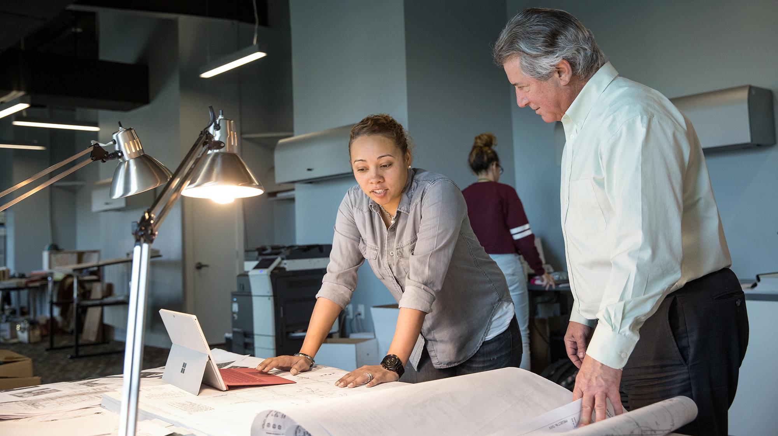
Talking to IT about Modernization and Accessibility
Mobility
Security
Compliance
Accessibility
Mobile Workers
Devices
Field Work
Commodity Devices
Digital Natives
Device Management
Content Control
Encryption
Phishing
Auditing
Internet of Things
Privacy
Content Protection
Archiving
Digital Assets
FOIA
Regulatory
Knowledge Capture
Accessibility of Content
Detecting Content
Guided Accessibility
Situational Disabilities
Workforce Inclusion
Training
Notes:
Working with GSA, we developing messaging about how Accessibility is part of Modernization of IT
Here is what IT is busy with. See Accessibility is off on the side

Slide 5
Modernization of IT = Accessibility
Mobility
Security
Compliance
Accessibility
Mobile Workers
Devices
Field Work
Commodity Devices
Digital Natives
Device Management
Content Control
Encryption
Phishing
Auditing
Internet of Things
Privacy
Content Protection
Archiving
Digital Assets
FOIA
Regulatory
Knowledge Capture
Accessibility of Content
Detecting Content
Guided Accessibility
Situational Disabilities
Workforce Inclusion
Training
Notes:
Need to drive Accessibility into the Modernization of IT
Adoption of Modern Platforms provides benefits to everyone and especially to PWD
Highlighted are some areas that map easily
Field Work – Situational Disability – Text to Speech or Speech to Text.
Knowledge Capture – Brain Drain with aging employees – A11y extends the time they stay in workforce
Digital Assets – Closed Captioning all videos allows for search by all
Content Control – Accessible Content needs to be part of the controls

Slide 6
Demos
Aging Employees and Knowledge Capture
Clinician Mobility with Dragon Naturally Speaking
Inclusive Meetings
Notes:
Demos
Aging – Word Reader Mode
Clinician – DNS into SP or Word
Inclusive Meetings – PowerPoint Speech to Text Add-in

Slide 7
Question Time
What are your Challenges with IT Modernization and Accessibility?

